Slide 1
Lecture 02
Path to Lecture Folder: \\sandata\Xeon\Fall 2018\Bismillah Jan
Data Representation and Number System

Slide 2
Computers Process Data
Computers are used to process all types of information in a broad spectrum fields. For example
  Numeric data consisting of Integers and real numbers are used in programs calculating payroll. We typically perform arithmetic operations on numeric data.
  Strings of alphabets and numbers (Alphanumeric Data) are processed in customer record keeping systems.

Slide 3
Computers Process Data
Multimedia content including images, sound and text are frequently used in a large collection of application areas.
Signals representing various types of information like temperature, pressure, presence or absence of objects etc. are processed by computers in Robotics, IoT, monitoring and control applications.
…

Slide 4
Computer store data in memory
Digital computers have been made such that all data and instructions(program) for processing must be stored in computers memory before processing.
TODAY WE ARE GOING TO LEARN HOW VARIOUS TYPES OF DATA/INFORMATION IS REPRESENTED IN A MODERN COMPUTER’S MEMORY AND SOME IDEA OF HOW THE PROCESSING IS DONE.

Slide 5
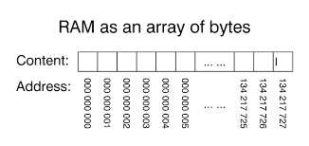
WHAT IS Random Access MEMORY(RAM)?
A computer scientists view memory as a sequence of Bytes with each byte having a unique address.
  Byte is enough space to store a alphabet/character.

Slide 6
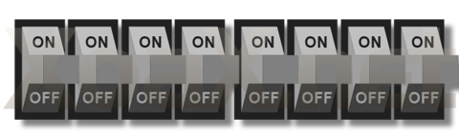
What is inside a Byte?
Byte is enough space to store a alphabet/character.
We view a byte consisting of eight bi-state circuits/switches
Each circuit/switch can either be in the ON state or OFF state or it hold either positive charge or negative charge.
A byte consists of 8 such switches/circuits and each one of
these switches is known as a Bit.

Slide 7
What can be represented using a Bit
Single Bit can be used to represent two different quantities
  ON means TRUE and OFF means FALSE
  ON means number 79 and OFF means number -23
  ON means 23.5 and OFF means 39.25
  ON means RED COLOR and OFF means BLUE COLOR
  …
Most commonly ON means 1 and OFF means 0 and therefore Bit is also known as Binary Digit (Bit)

Slide 8
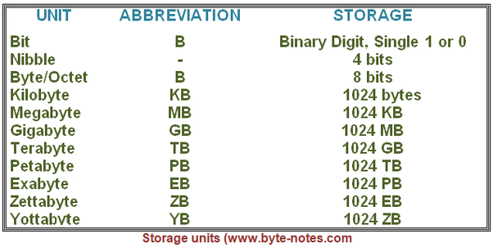
Memory Measuring Units
(As viewed by computer scientists)

Slide 9
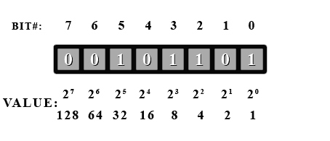
Bits within Bytes and Place Value
Bits within a byte have Place and a Place Value with least significant bit at place 0 and most significant bit at place 7.
Bit at place i has place value 2^{i}

Slide 10
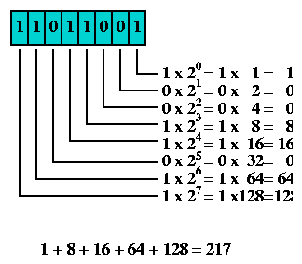
Bytes as Numbers
We can view each byte as a binary number. For Example the following Binary number represents the quantity two hundred and seventeen
Can you see the similarity between Binary and Decimal numbers?

Slide 11
Exercise # 1
Note: Write exercises on a separate page, you have to submit it at the end of lecture
What Quantities are Represented by the following 8-bit binary numbers.
Bit# | 7 | 6 | 5 | 4 | 3 | 2 | 1 | 0
a. | 0 | 1 | 1 | 1 | 0 | 1 | 0 | 1
b. | 1 | 0 | 1 | 1 | 1 | 0 | 1 | 1
c. | 0 | 1 | 0 | 0 | 0 | 1 | 0 | 0
d. | 1 | 0 | 1 | 0 | 0 | 0 | 0 | 0
e. | 0 | 0 | 0 | 0 | 1 | 1 | 1 | 1

Slide 12
Exercise # 2
If a Byte is assumed to represent a number, as described earlier, then what is the range (minimum and maximum values) of numbers that can be stored in a 8-bit Byte?

Slide 13
Representing a Decimal Number in Binary
Let us solve the reverse problem of representing a number within a byte using the idea of place value.
Bit# | 7 | 6 | 5 | 4 | 3 | 2 | 1 | 0
value | 128 | 64 | 32 | 16 | 8 | 4 | 2 | 1
8 = | 0 | 0 | 0 | 0 | 1 | 0 | 0 | 0
128 = | 1 | 0 | 0 | 0 | 0 | 0 | 0 | 0
64= | 0 | 1 | 0 | 0 | 0 | 0 | 0 | 0
96 = 64 + 32 | 0 | 1 | 1 | 0 | 0 | 0 | 0 | 0
250=128+64+32+16+8+2 | 1 | 1 | 1 | 1 | 1 | 0 | 1 | 0

Slide 14
Exercise # 3
Represent each of the following quantities as 8-bit binary number.
Bit# | 7 | 6 | 5 | 4 | 3 | 2 | 1 | 0
value | 128 | 64 | 32 | 16 | 8 | 4 | 2 | 1
27
139
164
196
259

Slide 15
How can we represent a character?
IDEA.
  Assign numeric codes to characters and represent each character in a Byte using it’s numeric code.
  Can we assign numeric codes of our choice to each character?. What might be a problem with this approach?

Slide 16
How can we represent a character?
IDEA
  Create a Standard coding scheme so that information can be easily shared between devices from different vendors.
Standard Codes
  ASCII
  Unicode
  Unicode Transformation Format(UTF) UTF-8, UTF-16
  ANSI Character Set
  …

Slide 17
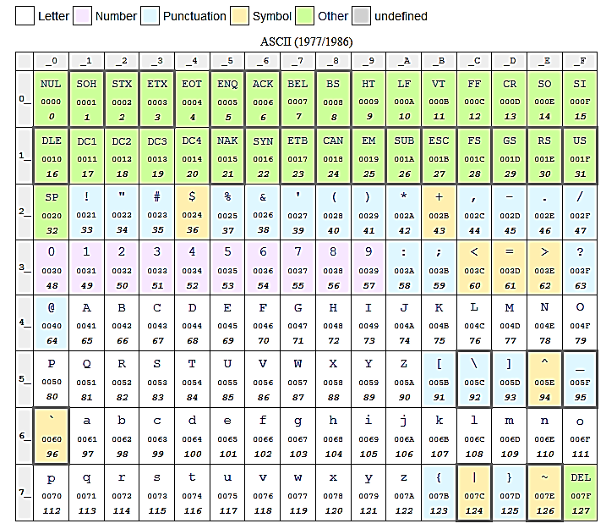
ASCII Character Encoding

Slide 18
Exercise # 4
The following 23 values represents a message consisting of 23 characters stored in RAM.
If the message has been written using 8-Bit Extended ASCII codes then decipher the message
87 104 97 84 32 105 83 32 89 111 117 82 32 76 65 83 116 32 78 65 77 69 63
WhaT iS YouR LASt NAME?

Slide 19
Exercise # 5
Use ASCII encoding to give answer to the question in the previous Exercise?

Slide 20
Representing Non-Negative(Unsigned) Integer Values
Idea No 1.
  Each integer is a sequence of characters and hence we can use character encoding to represent each quantity as a sequence of characters.

Slide 21
Exercise # 5
Represent the following integer quantities as sequence of bytes encoded using ASCII characters.
20456
196
1024
32
100015

Slide 22
Representing Non-Negative(Unsigned) Integer Values
Idea No 2.
  Integer quantities can be represented using the idea of place value using binary number system. That is each bit has a place value and total value stored is sum of all the place values included in the number.

Slide 23
Representing Non-Negative(Unsigned) Integer Values
Problem
  A byte has only eight bits and hence we can not represent quantities bigger than 255 in a byte. For processing integer quantities this is an unacceptably low value.
Solution
  Use 2 or more bytes to store an integer quantity

Slide 24
Exercise # 6
Use 2-Bytes to represent each of the following quantity
What is the Maximum unsigned integer value that can be represented using 2 Bytes?
20456
196
1024
32
100015
= 01001111 11101000

Slide 25
Exercise # 7
Use 4-Bytes to represent each of the following quantity
What is the Maximum unsigned integer value that can be represented using 4 Bytes?
20456
196
1024
32
100015
= 00000000 00000000 01001111 11101000

Slide 26
Representing signed Integer Values
Problem
  How can we represent Signed (Both negative and positive) numbers?
Solution
  FIX ONE OF THE BIT FOR REPRESENTING SIGN
  (Sign-Magnitude method)
  Use 2’s Complement Representation (Optional)
    Place value of the most significant bit is considered negative

Slide 27
Exercise
Represent each of the following quantity in 2-bytes using
sign-magnitude method.
65536
196
-65535
-32
100015

Slide 28

How to represent images in RAM?
Image is a rectangular collection{array} of samples.
IDEA
  Let’s represent as a value of color at each sample point.
Color at each point can be the amounts of RED, GREEN and BLUE colors to makeup the color.
  We can represent color at each point as three unsigned numbers and hence we might use three bytes to represent each color value

